Slide 1
Social Media Data Analysis Using SQL
Presentation
Komara Lakshmi Malleswari
Sirigireddy Harish Reddy
Ramichetty Niranjan
Yalamakuri Suresh

Slide 2
Project Introduction
Aim
To analyze social media data using MySQL and SQL to understand user activity and engagement.
Objectives
Design a relational database.
Analyze users, posts, likes, comments, and shares.
Identify top-performing posts and active users.
Calculate and compare engagement.
Generate useful business insights using SQL.

Slide 3
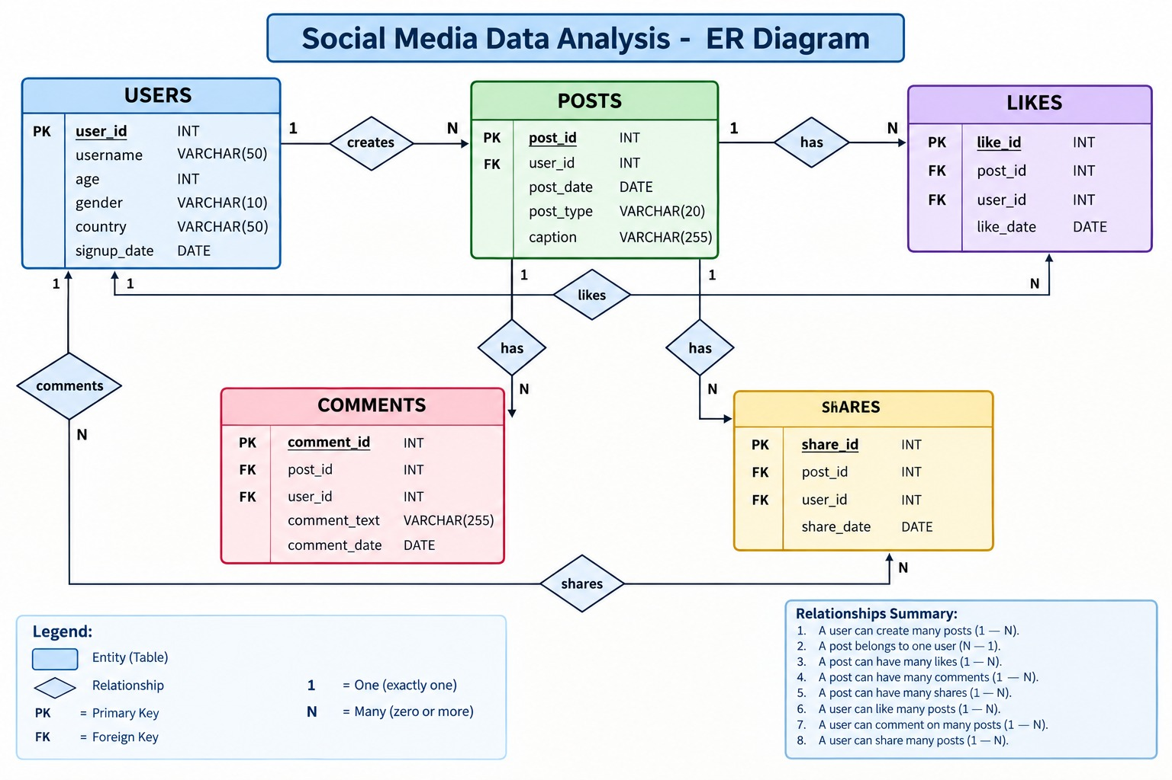
ER Diagram

Slide 4
Concepts Used
Database & Table Creation
Primary Key & Foreign Key
SELECT, WHERE, ORDER BY
INNER JOIN & LEFT JOIN
GROUP BY & HAVING
Aggregate Functions
Subqueries
Views
Stored Procedures
Window Functions

Slide 5
Queries
1. Display users with their posts :
SELECT u.user_id, u.username, p.post_id, p.post_type, p.post_date, p.caption FROM users u INNER JOIN posts p ON u.user_id = p.user_id;
2. Display all users and their posts:
SELECT u.user_id, u.username, p.post_id, p.post_type FROM users u LEFT JOIN posts p ON u.user_id = p.user_id;
3. Display detailed user-post information
SELECT p.post_id, u.username, u.country, u.gender, p.post_date, p.post_type, p.caption FROM users u JOIN posts p ON u.user_id = p.user_id;
4. Count total posts by each user
SELECT u.username, COUNT(p.post_id) AS total_posts FROM users u LEFT JOIN posts p ON u.user_id = p.user_id GROUP BY u.user_id, u.username;
5. Count users by country:
SELECT country, COUNT(*) AS total_users FROM users GROUP BY country;

Slide 6
CONTI…..
6. Count posts by post type :
SELECT post_type, COUNT(*) AS total_posts FROM posts GROUP BY post_type;
7. Query the user-post summary view
SELECT * FROM user_post_summary WHERE total_posts > 1;
8. Display top 5 posts by engagement :
SELECT * FROM post_engagement ORDER BY total_engagement DESC LIMIT 5;
9. Execute procedure to get user details
CALL GetUserDetails(1);
10. Execute procedure to get user's posts
CALL GetUserPosts(1);
11. Display post engagement view
SELECT * FROM post_engagement;

Slide 7
CONTI….
Window Functions & Ranking
12. Rank posts based on engagement
SELECT
post_id,
caption,
total_likes,
total_comments,
total_shares,
total_engagement,
RANK() OVER (
ORDER BY total_engagement DESC
) AS engagement_rank
FROM post_engagement;

Slide 8
Advantages
Organized Data:
Stores social media data in structured relational tables.
Efficient Analysis:
SQL makes it easy to filter, join and aggregate data.
Engagement Analysis:
Measures likes, comments and shares.
Content Analysis:
Identifies high-performing content types and posts.
User Analysis:
Helps identify active users and user behavior.

Slide 9
Future Enhancements
Power BI Dashboard:
Create interactive dashboards for users, posts and engagement.
Real-Time Data:
Connect the database with real-time social media APIs.
Machine Learning:
Predict post engagement and identify trending content.
Sentiment Analysis:
Classify comments as positive, negative or neutral.

Slide 10
THANK YOU

